Slide 1
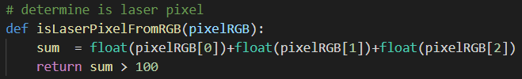
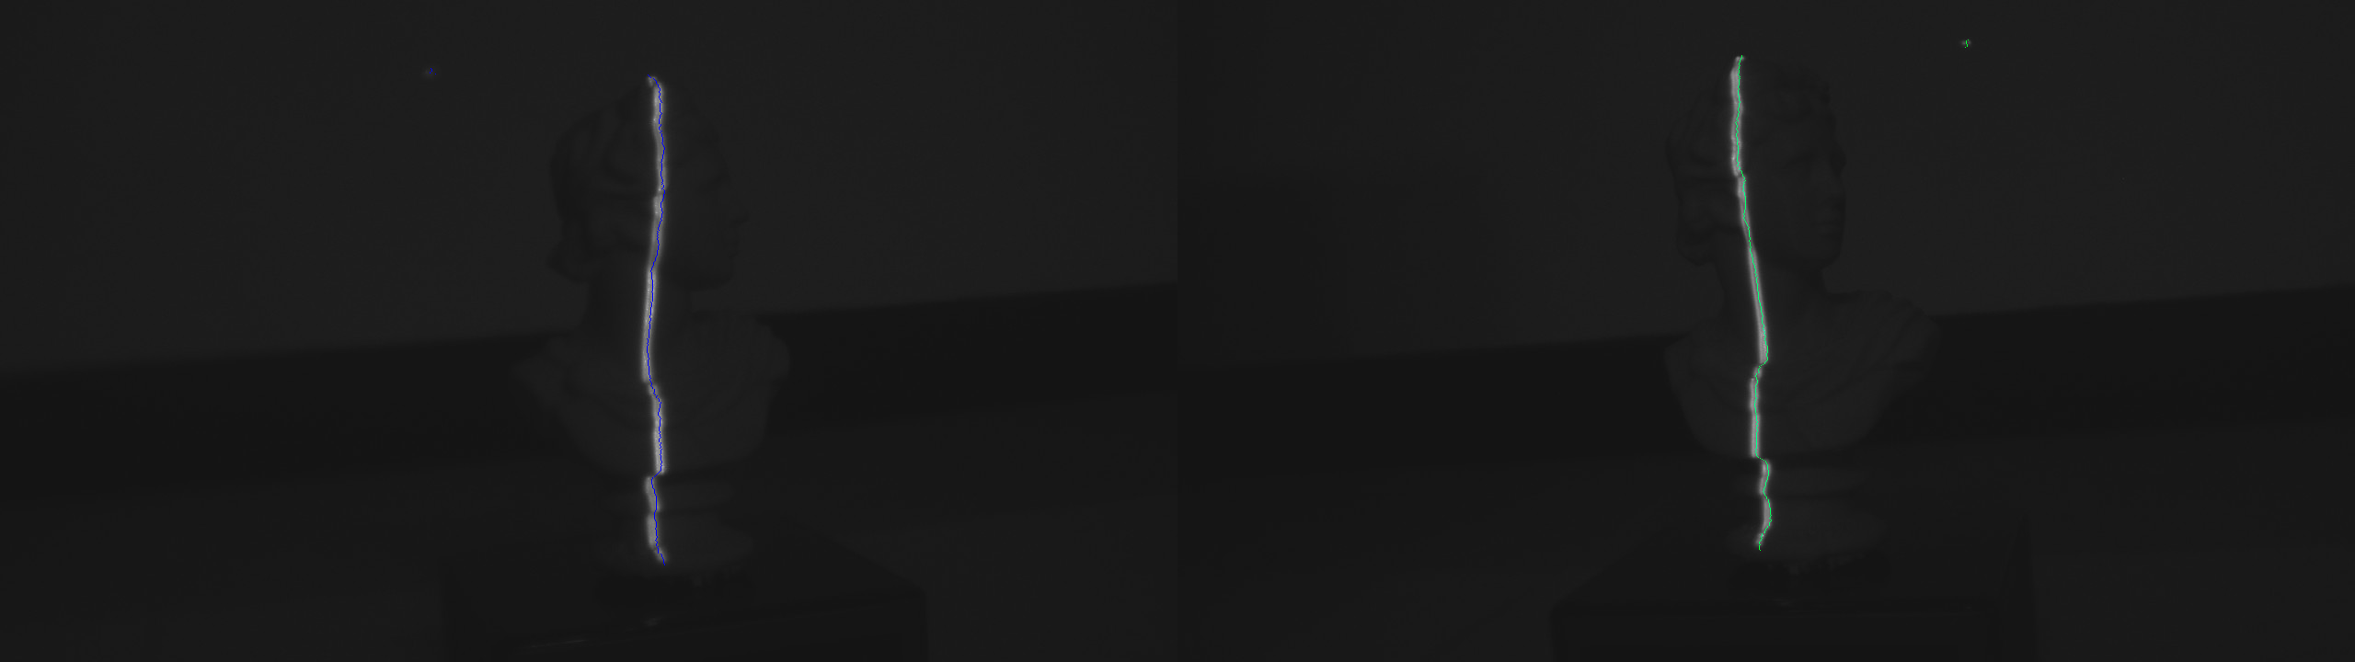
Find Bright pixel as feature point
Left features mark as blue pixel
Right features mark as green pixel

Slide 2

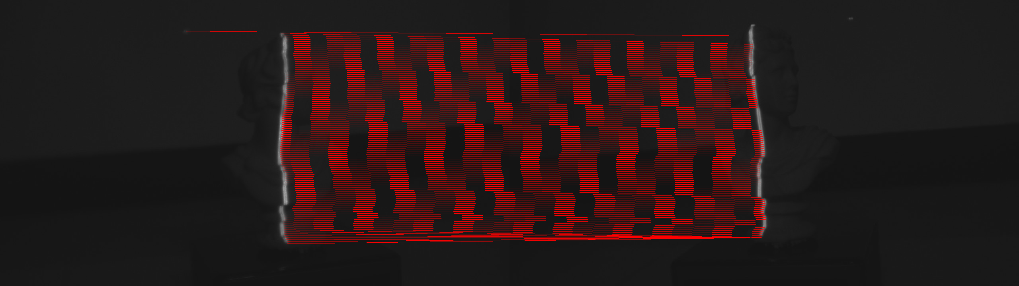
Match feature points set by fundamental matrix error
Go through all right features to find a pixel with minimum error for a left feature, and iterate all left features to get matched pixel.
Features match result

Slide 3
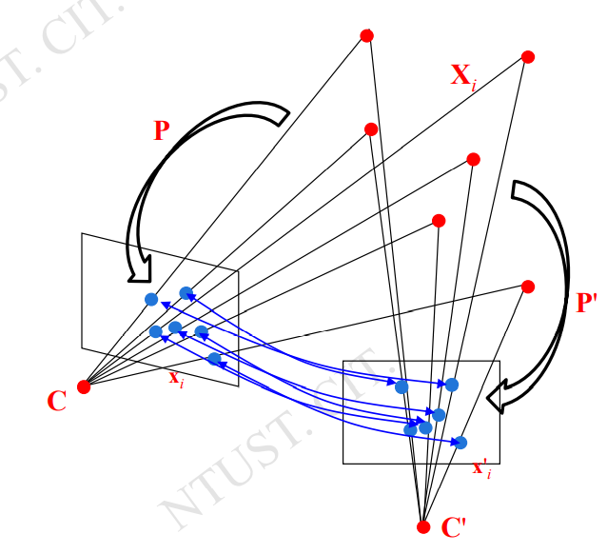
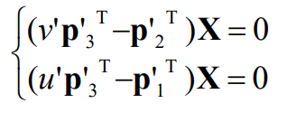
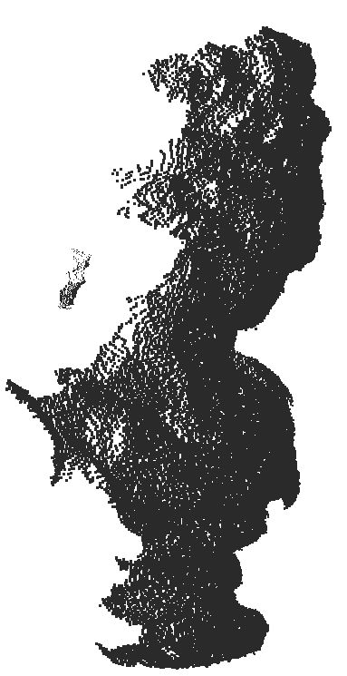
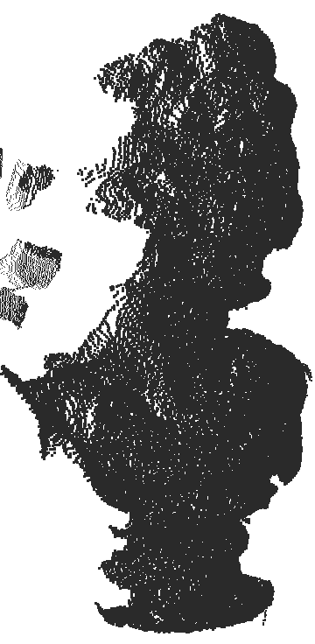
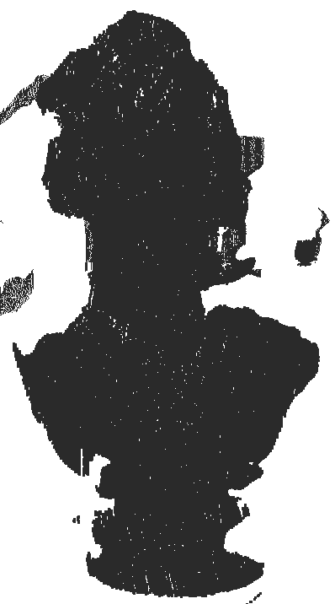
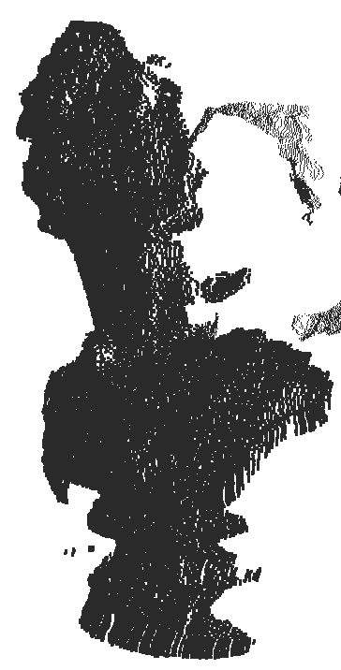
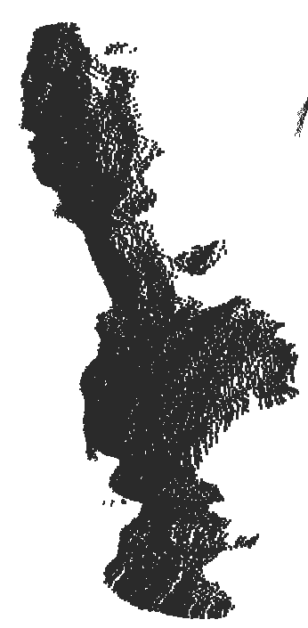
Final Reconstrcut result
Use Direct Triangulation Method find 3d point and save in .xyz format

